Slide 1
Agenda
What is HTML?
Basic Structure of an HTML Document
HTML Tags and Elements
Attributes in HTML
HTML Headings
Paragraphs and Formatting
Links and Images
Lists and Tables
Forms in HTML
Summary and QA

Slide 2
What is HTML?
Stands for HyperText Markup Language
Standard language for creating web pages
Describes the structure of a web page
Uses a series of elements and tags
HTML documents are plain text files
Rendered by web browsers
Essential for web development

Slide 3
HTML Versions
HTML was created by Sir Tim Berners-Lee in late 1991.
HTML 1.0 released in 1993 - sharing information - readable and accessible via web browsers.
HTML 2.0, published in 1995- all the features of HTML 1.0 along with that few additional features.
HTML 3.0, - Dave Raggett who introduced a fresh paper or draft - giving more powerful characteristics for webmasters in designing web pages.
But these powerful features of new HTML slowed down the browser
HTML 4.01, which is widely used and was a successful version of HTML
HTML 5 can be said for an extended version of HTML 4.01, which was published in the year 2012.

Slide 4
HTML Tags and Elements
Tags are the building blocks of HTML
Element consists of a start tag, content, and end tag
Example: <p>This is a paragraph.</p>
Empty elements: <br> or <img>
Case-insensitive but commonly written in lowercase
Can be nested within each other
Must be properly closed
mark-up languages are not compiled or interpreted, just displayed.
So even if mistakes are made, no error messages shown in Html, just the expected output will not be seen.

Slide 5
Attributes in HTML
Provide additional information about elements
Always included in the opening tag
Written as name/value pairs
Example: <a href="https://example.com">Link</a>
Common attributes: id, class, style
Must be quoted
Improve functionality and styling

Slide 6
Terminologies
WWW – World Wide Web.
HTML – HyperText Markup Language – The Language of Web Pages on the World Wide Web.
HTML is a text formatting language.
URL – Uniform Resource Locator.
Browser – A software program which is used to show web pages.
Pages end with “.htm” or “.html”

Slide 7
Html Editors
HTML Editor – A word processor that has been specialized to make the writing of HTML documents more effortless.
There are many different programs that you can use to create web documents.
HTML Editors enable users to create documents quickly and easily by pushing a few buttons. Instead of entering all of the HTML codes by hand.
These programs will generate the HTML Source Code for you.
Simplest too to create html documents is Notepad.

Slide 8
Html Editors
Adobe Dreamweaver
Bluefish
Google Web Designer
Sublime Text
CoffeeCup
HtmlKit
Mobirise
VSCode
Notepad ++

Slide 9
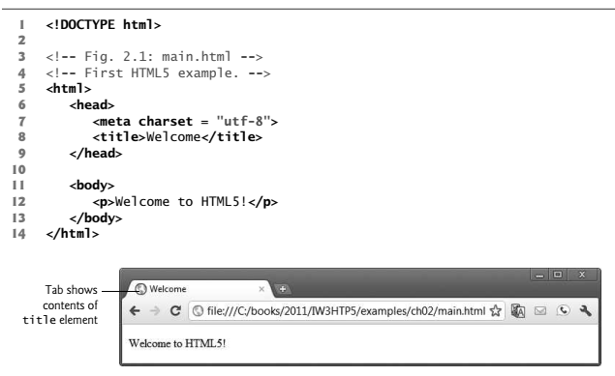
Creating a Basic Starting Document

Slide 10
Document type
First step in creating Html document is indicating its type.
Done with the help of <!DOCTYPE> declaration.
Required at the beginning of every Html document to help the browser how to render the Html document.
E.g. <!DOCTYPE Html>

Slide 11
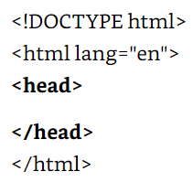
HTML sections
Html code inserterd between <Html> and </Html> divided into two main sections – Head and body.
<head>- Used to enclose information necessary to render the page, such as title, character encoding and external files required
<body> - This element delimits the content of the document.

Slide 12
Comment Statements
Comment statements are notes in the HTML code that explain the important features of the code
The comments do not appear on the Web page itself but are a useful reference to the author of the page and other programmers
To create a comment statement use the <!-- …. --> tags

Slide 13
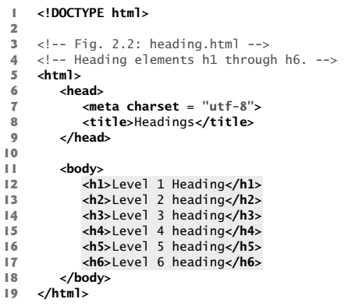
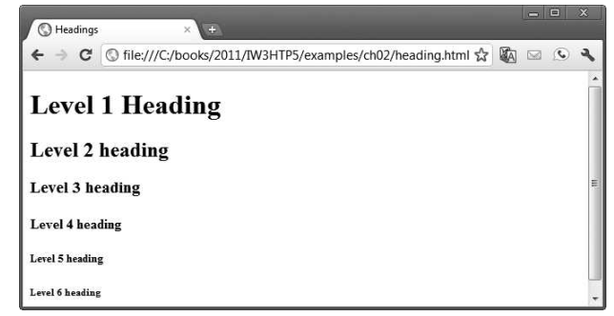
Heading element

Slide 14
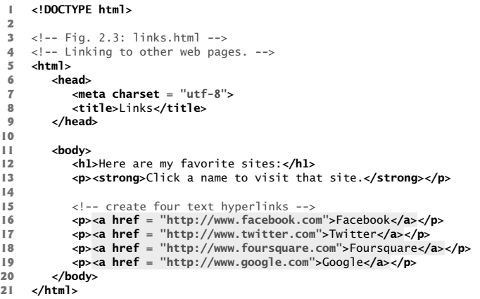
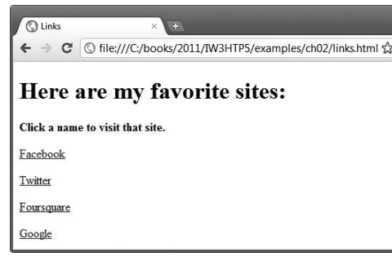
Linking Element

Slide 15
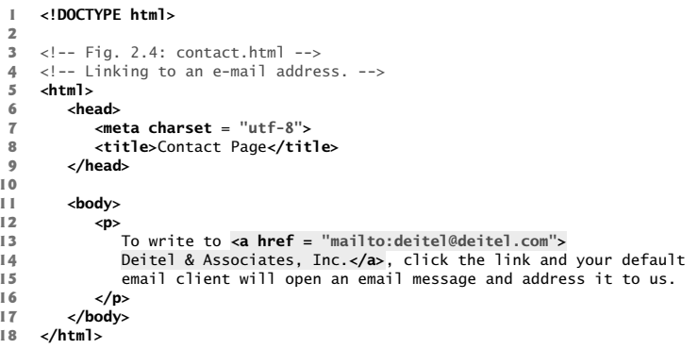
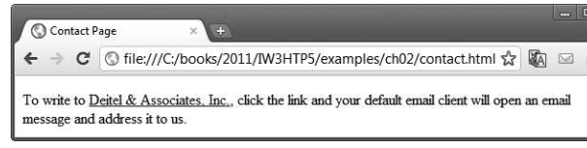
Hyperlink to email

Slide 16
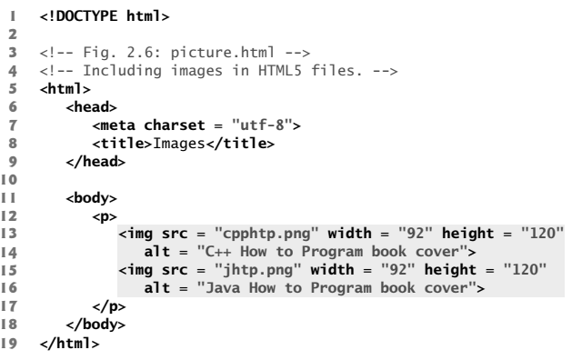
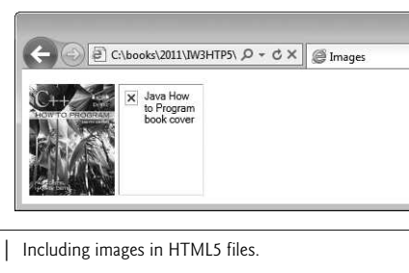
Images
document must have an alt attribute. If a browser cannot render an image, the browser displays the alt attribute’s value.

Slide 17
Image with Link
<a href="page.html"><img src="image.jpg" alt="Description"></a>
Combines image with link
Example: <a href="https://example.com"><img src="example.jpg" alt="Example Image"></a>
Clicking image navigates to https://example.com
Void Elements: contain only attributes and do not mark up text,
by using the forward slash character (/) inside the closing right angle bracket (>) of the start tag
<img src="logo.png" alt="logo“ width="150“ height="50“ > </img> normal tag
<img src="logo.png" alt="logo“ width="150“ height="50“ /> void element

Slide 18
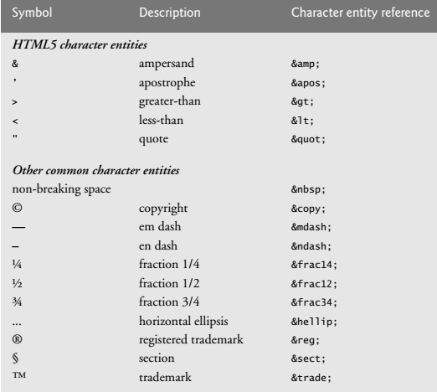
Special Characters and Horizontal rules
certain characters or symbols may be difficult to embed directly
<p> if x < 10 then increment x by 1</p>
<p>if x &lt; 10 then increment x by 1</p>

Slide 19
HTML Formatting Elements
<b> - Bold text
<strong> - Important text
<i> - Italic text
<em> - Emphasized text
<mark> - Marked text
<small> - Smaller text
<del> - Deleted text
<ins> - Inserted text
<sub> - Subscript text
<sup> - Superscript text

Slide 20
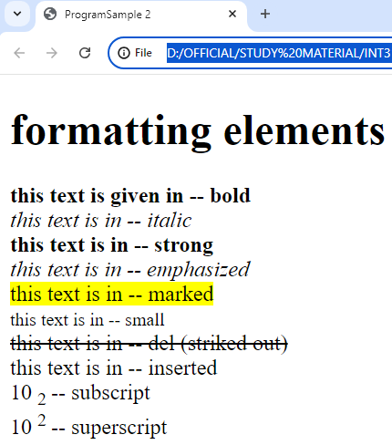
Program with Output
<!DOCTYPE html>
<html>
<head><title>ProgramSample 2</title></head>
<body>
<h1>formatting elements </h1>
<b> this text is given in -- bold </b> </br>
<i> this text is in -- italic </i> </br>
<strong> this text is in -- strong </strong></br>
<em> this text is in -- emphasized </em></br>
<mark> this text is in -- marked </mark></br>
<small> this text is in -- small </small></br>
<del> this text is in -- del (striked out)</del></br>
<in> this text is in -- inserted </in></br>
10
<sub> 2 </sub> -- subscript</br>
10
<sup> 2 </sup> -- superscript
</body>
</html>

Slide 21
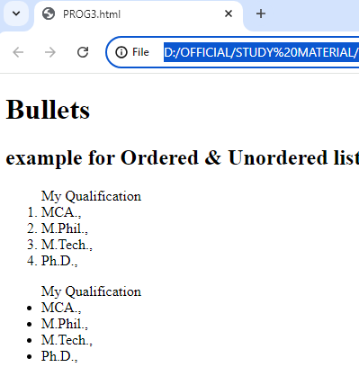
List
<!DOCTYPE html>
<html>
<body>
<h1> Bullets </h1>
<h2> example for Ordered &amp; Unordered list</h2>
<ol> My Qualification
<li>MCA.,</li>
<li>M.Phil.,</li>
<li>M.Tech.,</li>
<li>Ph.D.,</li>
</ol>
<ul> My Qualification
<li>MCA.,</li>
<li>M.Phil.,</li>
<li>M.Tech.,</li>
<li>Ph.D.,</li>
</ul>
</body>
</html>

Slide 22
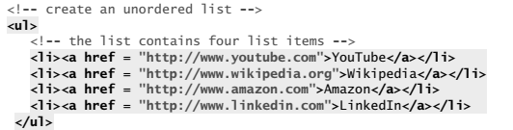
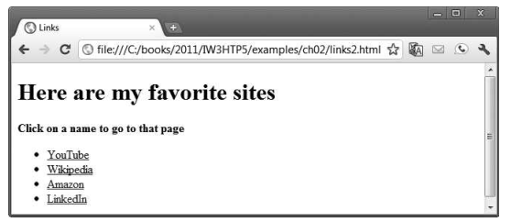
Un ordered List containing hyperlinks

Slide 23
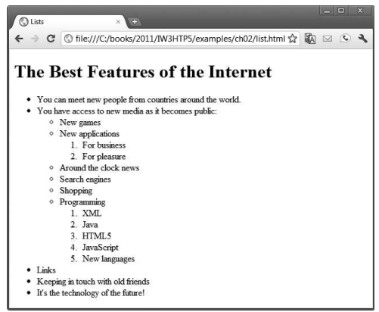
Can you make a code for this..?

Slide 24
Tables
A table represents information in a grid format.
Mainly used in alignment of controls in web page.
To create a basic table structure you need to use <table>, <tr> <th> and <td>.
<tr> is used to create row and
<td> will be used to create column.

Slide 25
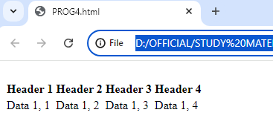
Tables
<table>
<tr>
<th>Header 1</th>
<th>Header 2</th>
<th>Header 3</th>
<th>Header 4</th>
</tr>
<tr>
<td>Data 1, 1</td>
<td>Data 1, 2</td>
<td>Data 1, 3</td>
<td>Data 1, 4</td>
</tr>
</table>

Slide 26
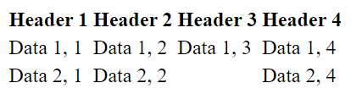
Tables
<table>
<tr>
<th>Header 1</th>
<th>Header 2</th>
<th>Header 3</th>
<th>Header 4</th>
</tr>
<tr>
<td>Data 1, 1</td>
<td>Data 1, 2</td>
<td>Data 1, 3</td>
<td>Data 1, 4</td>
</tr>
<tr>
<td>Data 2, 1</td>
<td>Data 2, 2</td>
<td></td>
<td>Data 2, 4</td>
</tr>
</table>
Empty Cell

Slide 27
Tables
Important Attributes:
<table>: border, align, width, height etc.,
Border – Border width. A number.
<td>: valign, halign, rowspan, colspan, width, height etc.,
Align, valign (vertical align) and halign (horizontal align): - center, left, right
Rowspan – to merge rows. A number.
Eg: if rowspan=2 for a particular td, current td will be merged with previous 1 row’s td.
Colspan – to merge columns. A number.
Eg: if colspan=3 for a particular td, current td will be merged with previous 2 column’s td

Slide 28
Tables Attributes
BGColor: Some browsers support background colors in a table.
Width: you can specify the table width as an absolute number of pixels or a percentage of the document width. You can set the width for the table cells as well.
Border: You can choose a numerical value for the border width, which specifies the border in pixels.
CellSpacing: Cell Spacing represents the space between cells and is specified in pixels.

Slide 29
CellPadding: Cell Padding is the space between the cell border and the cell contents and is specified in pixels.
Align: tables can have left, right, or center alignment.
Background: Background Image, will be titled in IE3.0 and above.
BorderColor, BorderColorDark.

Slide 30
Table Caption
A table caption allows you to specify a line of text that will appear centered above or bellow the table.
<TABLE BORDER=1 CELLPADDING=2>
<CAPTION ALIGN=“BOTTOM”> Label For My Table </CAPTION>
The Caption element has one attribute ALIGN that can be either TOP (Above the table) or BOTTOM (below the table).

Slide 31
Adding a Border
The BORDER=n attribute allows you to add a border n pixels thick around the table
To make a solid border color, use the BORDERCOLOR=“color” attribute
To make a shaded colored border, use BODERCOLORDARK=“color” and BORDERCOLORLIGHT=“color”

Slide 32
Controlling Cell Spacing
Cell spacing is the space between cells while cell padding is the space around the contents of a cell
To control both types of spacing, use the CELLSPACING =n and CELLPADDING=n attributes in the <TABLE> tag

Slide 33
Changing a Cell’s Color
To change a cell’s color, add the BGCOLOR=“color” attribute to the <TD> tag
Example:
<TD BGCOLOR=“blue”>

Slide 34
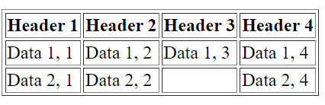
Tables
Border Property
<table border="1">
<tr>
<th>Header 1</th>
<th>Header 2</th>
<th>Header 3</th>
<th>Header 4</th>
</tr>
<tr>
<td>Data 1, 1</td>
<td>Data 1, 2</td>
<td>Data 1, 3</td>
<td>Data 1, 4</td>
</tr>
<tr>
<td>Data 2, 1</td>
<td>Data 2, 2</td>
<td></td>
<td>Data 2, 4</td>
</tr>
</table>

Slide 35
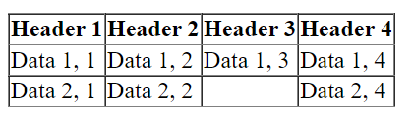
Tables
<table border="1" style="border-collapse: collapse">
<tr>
<th>Header 1</th>
<th>Header 2</th>
<th>Header 3</th>
<th>Header 4</th>
</tr>
<tr>
<td>Data 1, 1</td>
<td>Data 1, 2</td>
<td>Data 1, 3</td>
<td>Data 1, 4</td>
</tr>
<tr>
<td>Data 2, 1</td>
<td>Data 2, 2</td>
<td></td>
<td>Data 2, 4</td>
</tr>
</table>
CSS: Border Collapse

Slide 36
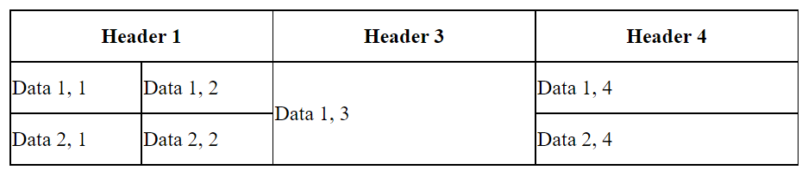
Tables
<table>
<tr>
<th colspan="2">Header 1</th>
<th>Header 3</th>
<th>Header 4</th>
</tr>
<tr>
<td>Data 1, 1</td>
<td>Data 1, 2</td>
<td rowspan="2">Data 1, 3</td>
<td>Data 1, 4</td>
</tr>
<tr>
<td>Data 2, 1</td>
<td>Data 2, 2</td>
<td>Data 2, 4</td>
</tr>
</table>
<style> table, th, td
{
border: 1px solid black;
border-collapse: collapse;
}
th
{
width: 200px;
}
tr
{
height: 40px;
}
</style>

Slide 37
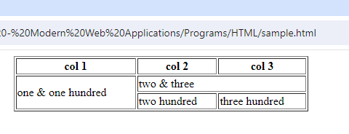
Table Example
<table border="1" width="30%" align="center">
<tr>
<th>col 1</th>
<th>col 2</th>
<th>col 3</th>
</tr>
<tr>
<td rowspan="2">one & one hundred</td>
<td colspan="2">two & three </td>
</tr>
<tr>
<td> two hundred </td>
<td> three hundred </td>
</tr>
</table>

Slide 38
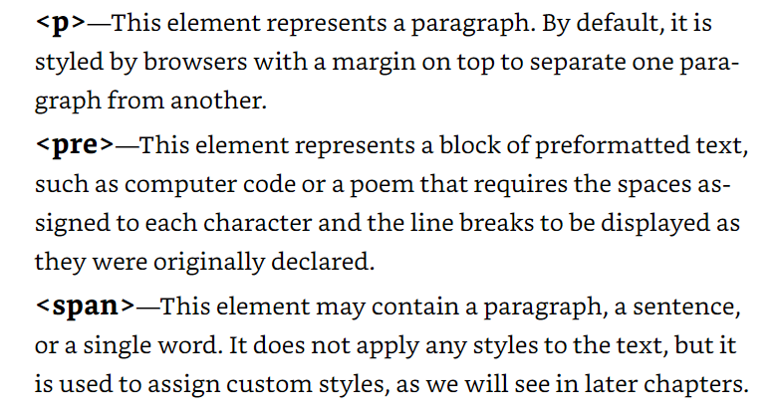
<p>, <pre>, <span>
The <span> tag is an inline container used to mark up a part of a text, or a part of a document.
The <span> tag is easily styled by CSS or manipulated with JavaScript using the class or id attribute.

Slide 39
Background Color
It is very common to see web pages with their background color set to white or some other colors.
To set your document’s background color, you need to edit the <BODY> element by adding the BGCOLOR attribute.
The following example will display a document with a white background color:
<BODY BGCOLOR=“#FFFFFF”></BODY>

Slide 40
TEXT Color
The TEXT attribute is used to control the color of all the normal text in the document. The default color for text is black.
The TEXT attribute would be added as follows:
<BODY BGCOLOR=“#FFFFFF” TEXT=“#FF0000”></BODY>
In this example the document’s page
color is white and the text would be red

Slide 41
Using Image Background
The BODY element also gives you ability of setting an image as the document’s background.
An example of a background image’s HTML code is as follows:
<BODY BACKGROUND=“hi.gif” BGCOLOR=“#FFFFFF”></BODY>

Slide 42
Aligning Text
The ALIGN attribute can be inserted in the <P> and <Hn> tags to right justify, center, or left justify the text
For example, <H1 ALIGN=CENTER> The New York Times </H1> would create a centered heading of the largest size

Slide 43
Page Formatting
To define the background color, use the BGCOLOR attribute in the <BODY> tag
To define the text color, use the TEXT attribute in the <BODY> tag
To define the size of the text, type <BASEFONT SIZE=n>

Slide 44
Example
<HTML>
<HEAD>
<TITLE> Example </TITLE>
</HEAD>
<body text="blue" bgcolor="yellow">
This is where you would include the text and images on your Web page.
</body>
</HTML>

Slide 45
Changing the Color of Links
The LINK, VLINK, and ALINK attributes can be inserted in the <BODY> tag to define the color of a link
LINK defines the color of links that have not been visited
VLINK defines the color of links that have already been visited
ALINK defines the color of a link when a user clicks on it

Slide 46
Frames
A framed page is made up of multiple HTML pages.
There is one HTML document that describes how to break up the single browser window into multiple windowpanes.
Each windowpane is filled with an HTML document.
Doc1.html
Doc2.html
Doc1.html
Doc2.html
Frames.html

Slide 47
Attributes of <frame>tag
src: is implemented for fetching the HTML file that needs to be loaded in one of the frames. It takes the value as filename.html or filename.htm within double-quotes.
name: facilitates you in giving a name to your frame, and hence you can indicate which frame(s) you are supposed to load into your page.
frameborder: is used for specifying if the borders are being shown in the frame you are using, and you can assign values either: 1 (yes) or 0 (no) for it.
marginwidth: facilitates in specifying the frame borders width spacing in the left and right sides. It takes the value in pixels.
marginheight: facilitates in specifying the frame borders height spacing in top and bottom sides. It also takes the value in pixels.

Slide 48
noresize: In general, it is possible to resize your frame just by clicking and dragging the frame borders. But this attribute helps users stop resizing the frames. It is written something like: noresize = "noresize".
scrolling: is used for activating and deactivating the scroll-bar appearance in your frame and takes either yes, no, or auto as values to be assigned to it within double-quotes.

Slide 49
Frame Page Architecture
A <FRAMESET> element is placed in the html document before the <BODY> element. The <FRAMESET> describes the amount of screen real estate given to each windowpane by dividing the screen into ROWS or COLS.
The <FRAMESET> will then contain <FRAME> elements, one per division of the browser window.
Because there is no BODY container, FRAMESET pages can't have background images and background colors

Slide 50
Example code
<!DOCTYPE html>
<html lang="en">
<head>
<meta charset="UTF-8">
<meta name="viewport" content="width=device-width, initial-scale=1.0">
<title>Document</title>
</head>
<frameset rows="30%,70%">
<frame name="f1" src="home.html"></frame>
<frameset cols="40%,60%">
<frame name="f2" src="PROG1.html"></frame>
<frame name="f3" src="PROG2.html"></frame>
</frameset>
</frameset>
</html>

Slide 51
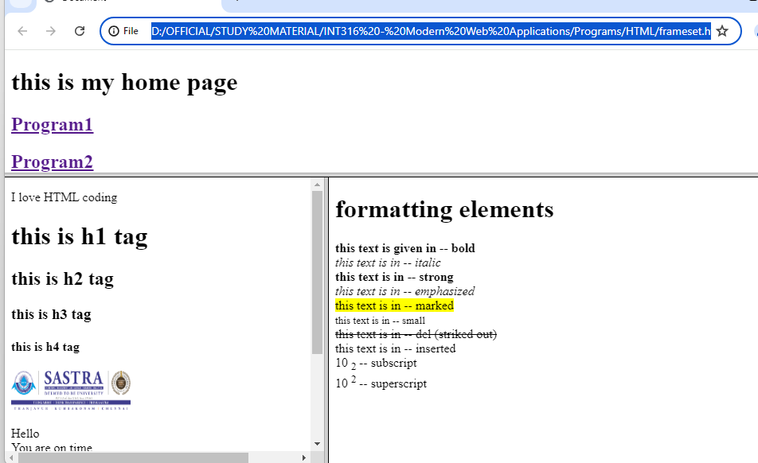
Output
Home.html
PROG1.html
PROG2.html

Slide 52
Example 2
<html>
<head> <title>Example for Frame</title> </head>
<frameset cols="20%,*">
<frame src="Ol.html"> 1st FRAME
<frame src="marquee.html"> 2nd FRAME </frameset>
</html>

Slide 53
Drawbacks of frames
Using frames has some disadvantages, so it is not recommended to use frames in the HTML document. These are:
There are small devices (mobile or other smartphones) that cannot cope with the size and features of frames mostly because these device-screens aren't large enough for making this splitting up, which is done by <frame>.
Screen resolution has an adverse effect on frames that you will create in some devices.

Slide 54
FRAMEBORDER : Possible values 0, 1, YES, NO. A setting of zero will create a borderless frame.
FRAMESPACING: This attribute is specified in pixels. If you go to borderless frames you will need to set this value to zero as well, or you will have a gap between your frames where the border used to be.
BORDER(thickness of the Frame): This attribute specified in pixels. A setting of zero will create a borderless frame. Default value is 5.
BORDERCOLOR: This attribute is allows you choose a color for your border. This attribute is rarely used.

Slide 55
<NOFRAMES>
<NOFRAMES>: Frame – capable browsers ignore all HTML within this tag including the contents of the BODY element. This element does not have any attributes.
<HTML>
<HEAD>
<TITLE> Framed Page </TITLE>
</HEAD>

Slide 56
Frameset
<FRAMESET COLS="23%,77%">
<FRAME SRC="" NAME="left_pane“>
<FRAME SRC="" NAME="right_pane">
<NOFRAMES>
<P> This is a Framed Page. Upgrade your browser to support frames.</P>
</NOFRAMES></FRAMESET>

Slide 57
<iframe> (HTML 5.0)
<!DOCTYPE html>
<html lang="en">
<head>
<meta charset="UTF-8">
<meta name="viewport" content="width=device-width, initial-scale=1.0">
<title>iframes example</title>
</head>
<body>
<iframe src="home.html" height=200px width=1300px></iframe>
<iframe src="PROG1.html" name="f1" height="500px" width="500px"></iframe>
<iframe src="PROG2.html" name="f2" height="500px" width="800px"></iframe>
</body>
</html>

Slide 58
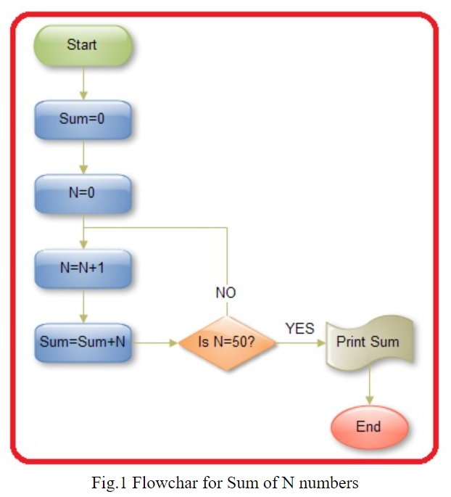
figure Element and figcaption Element
<figure align="center">
<img src="images\sumflow.jpg">
<figcaption>Fig.1 Flowchar for Sum of N numbers</figcaption>
</figure>

Slide 59
Div Element
Defines a division or a section in an HTML document
Used as a container for HTML elements
Styled with CSS
Manipulated with JavaScript
Easily styled by using the class or id attribute
Any sort of content can be put inside the <div> tag!
By default, browsers always place a line break before and after the <div> element.

Slide 60
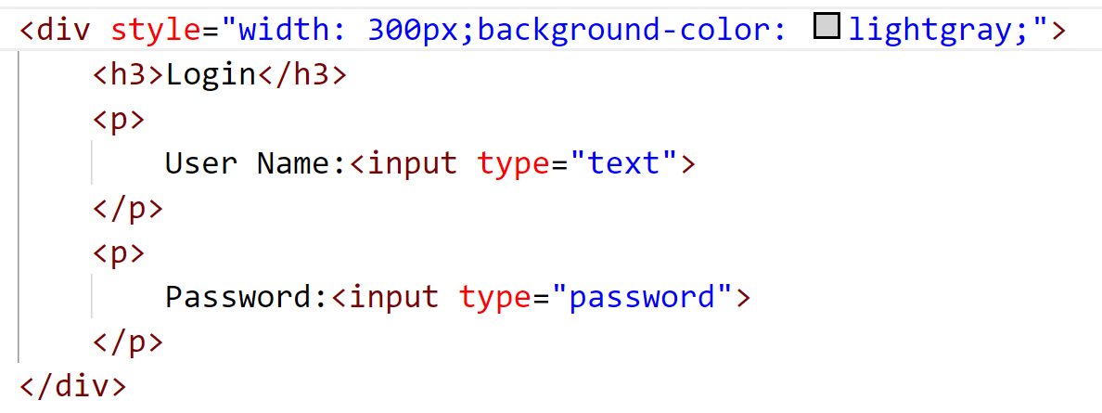
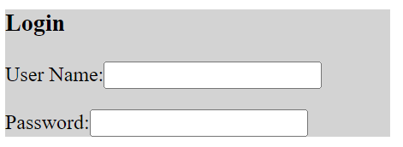
Div Element

Slide 61
Page Structure Elements

Slide 62
Section Element
Represents a generic standalone section of a document, which doesn't have a more specific semantic element to represent it.
Defines the section of documents such as chapters, headers, footers or any other sections.
Sections should always have a heading, with very few exception.

Slide 63
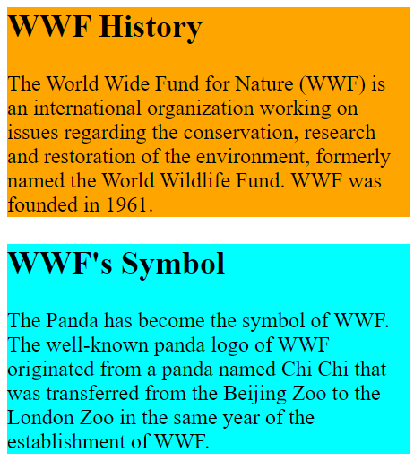
section Element
<section id="1" style="background-color:orange;width: 300px;">
<h2>WWF History</h2>
<p>The World Wide Fund for Nature (WWF) is an
international organization working on issues
regarding the conservation,
research and restoration of the environment,
formerly named the World Wildlife Fund.
WWF was founded in 1961.</p>
</section>
<section id="2" style="background-color:aqua;width: 300px;">
<h2>WWF's Symbol</h2>
<p>The Panda has become the symbol of WWF.
The well-known panda logo of WWF originated
from a panda named Chi Chi that was transferred
from the Beijing Zoo to the London Zoo
in the same year of the establishment of WWF.</p>
</section>

Slide 64
Header & Footer Elements
Header
Creates a header-content that usually appears at the top of the page contains both text and graphics.
Can be used multiple times on a page and can include HTML headings (<h1> through <h6>), navigation, images and logos and more.
Footer
Describes a footer—content that usually appears at the bottom of the page or section element.

Slide 65
figure Element and figcaption Element
Figure element
Describes a figure (such as an image, chart or table) in the document so that it could be moved to the side of the page or to another page.
Figcaption element
provides a caption for the image in the figure element.

Slide 66
Page-Structure Elements
HTML5 introduces several new page-structure elements (Fig. 3.18) that meaningfully identify areas of the page as headers, footers, articles, navigation areas, asides, figures and more.

Slide 67
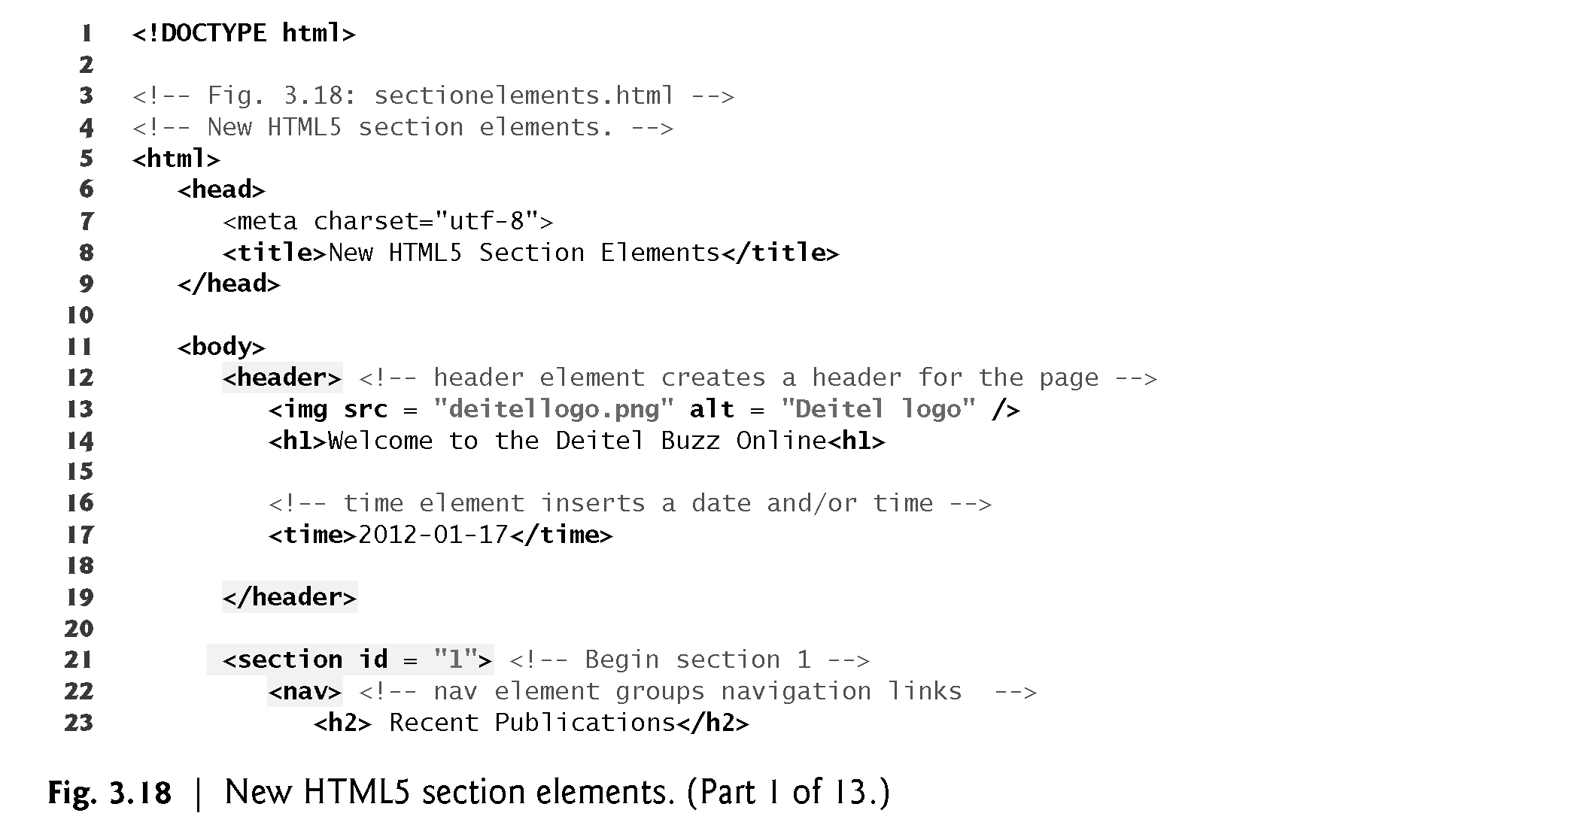

Slide 68
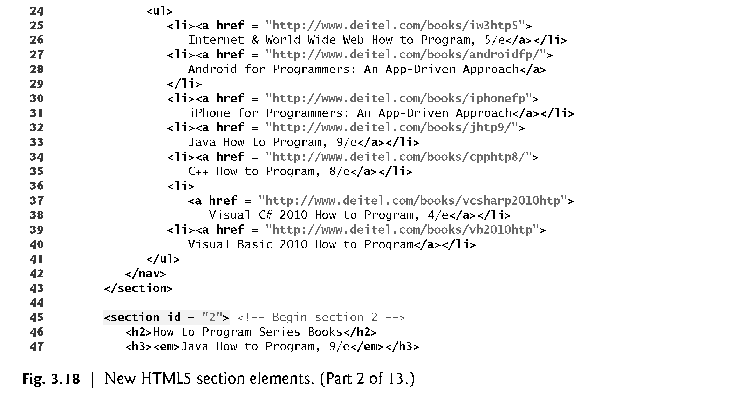

Slide 69
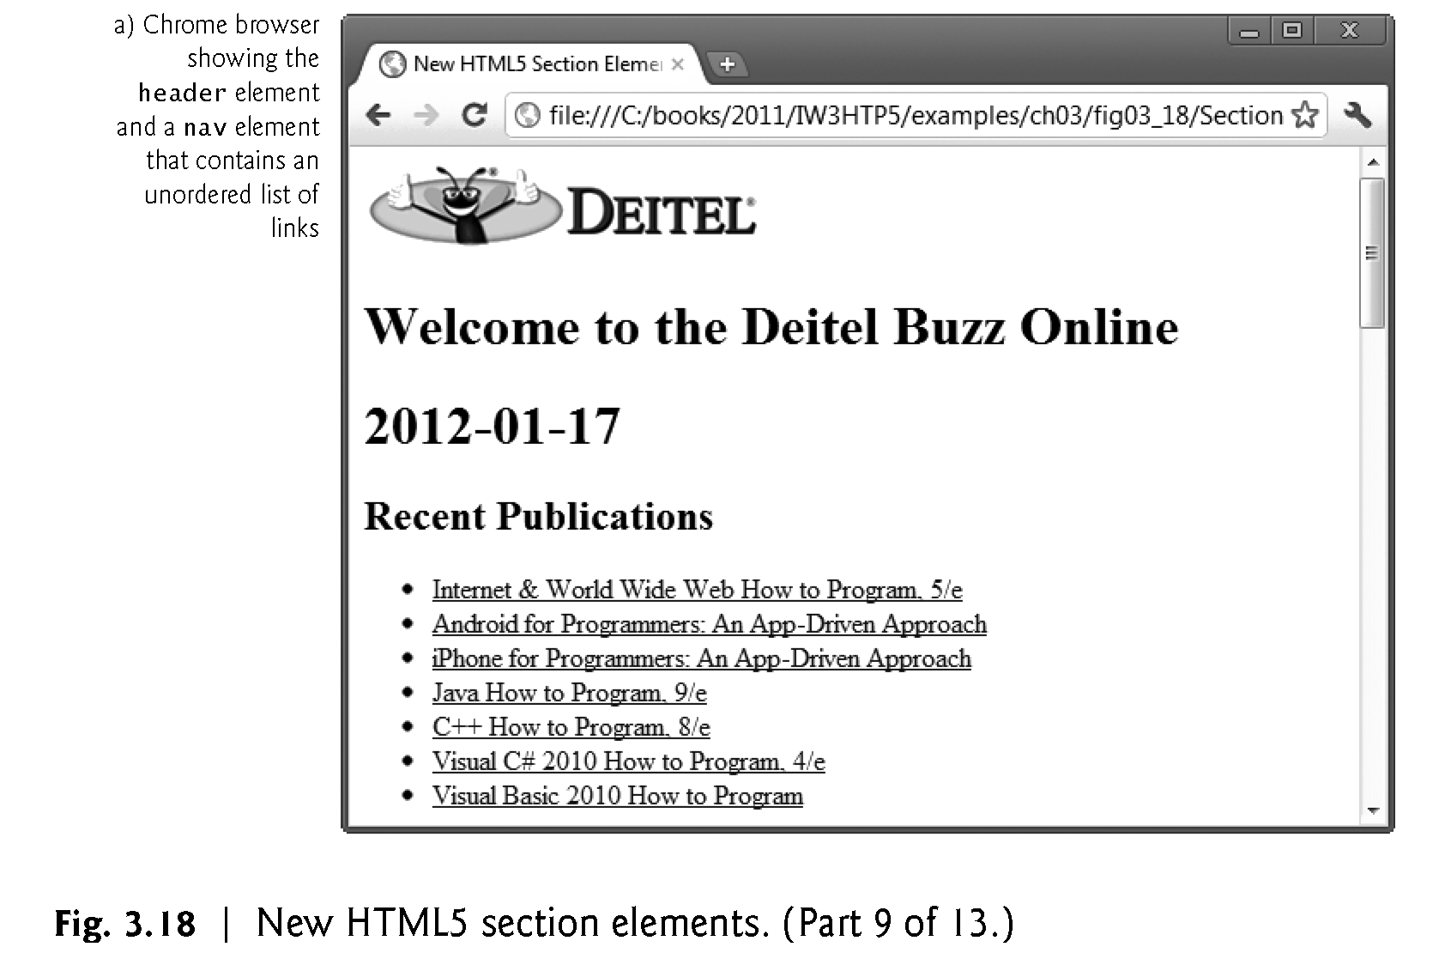

Slide 70
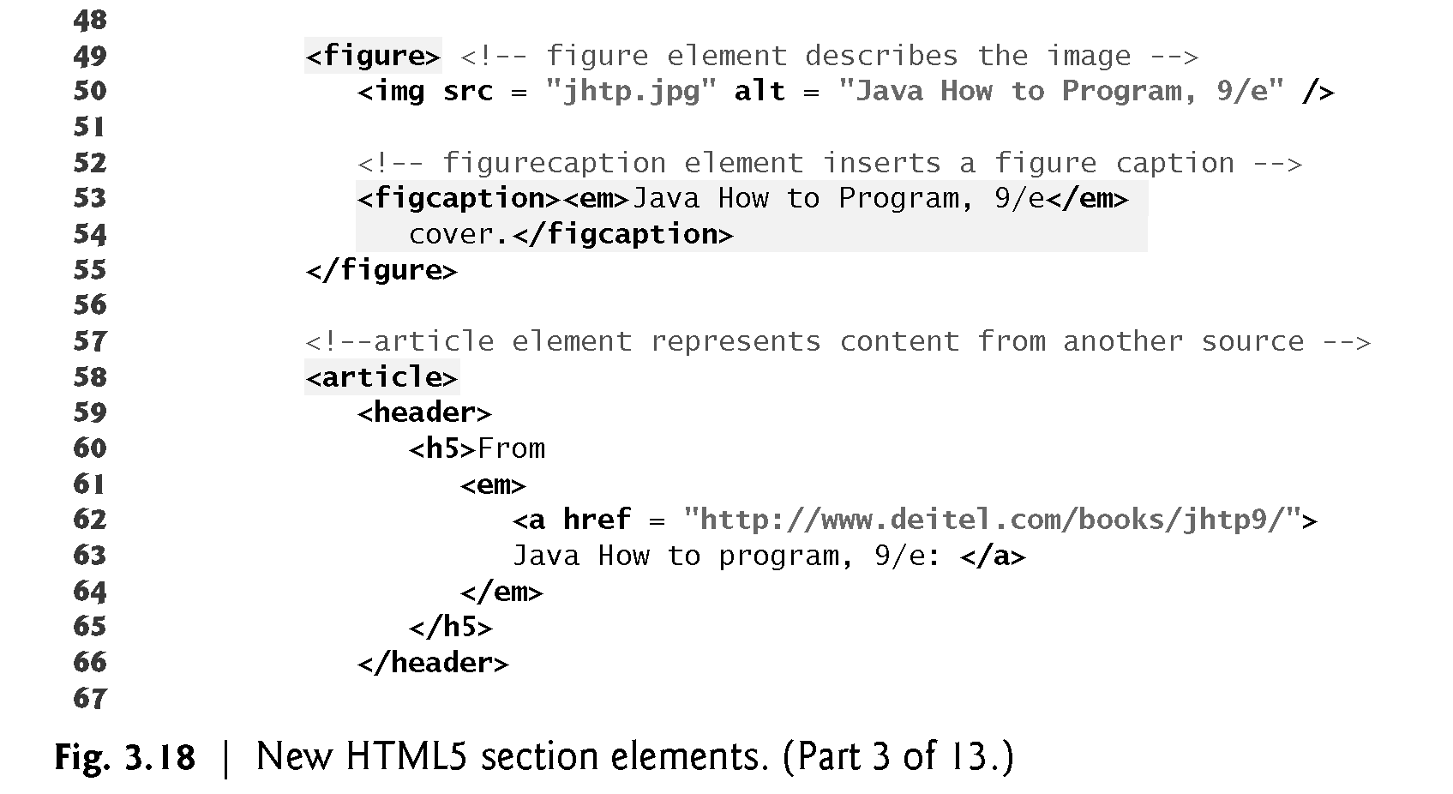

Slide 71
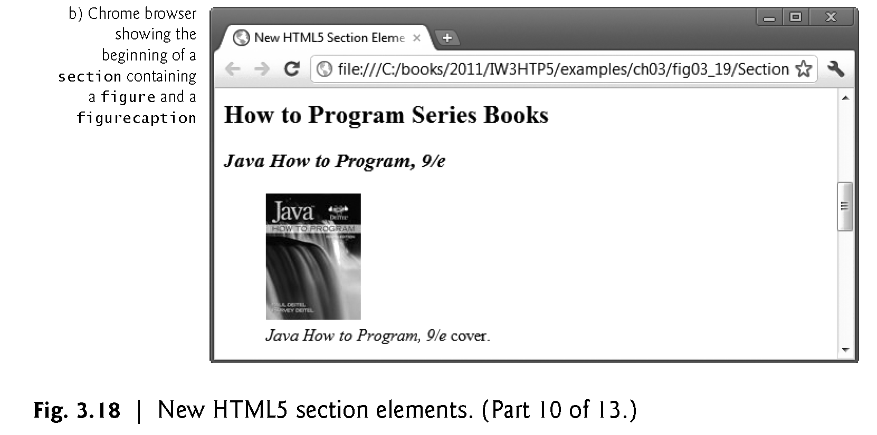

Slide 72
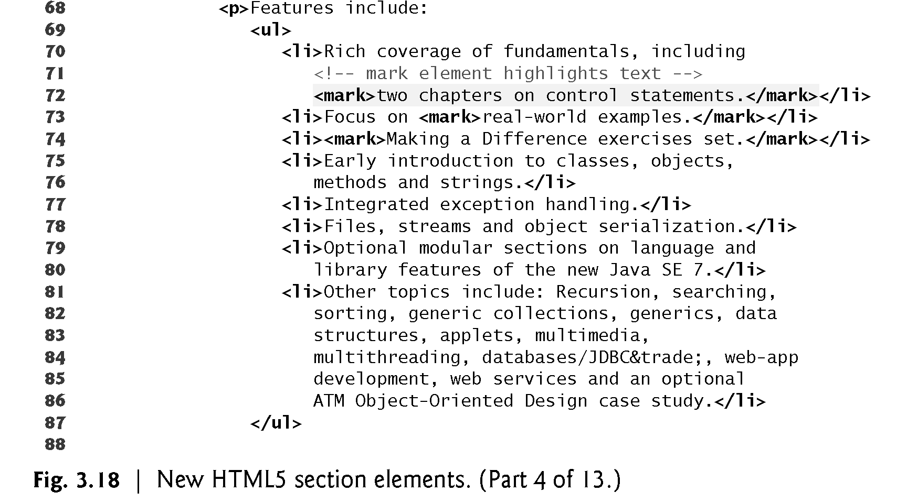

Slide 73
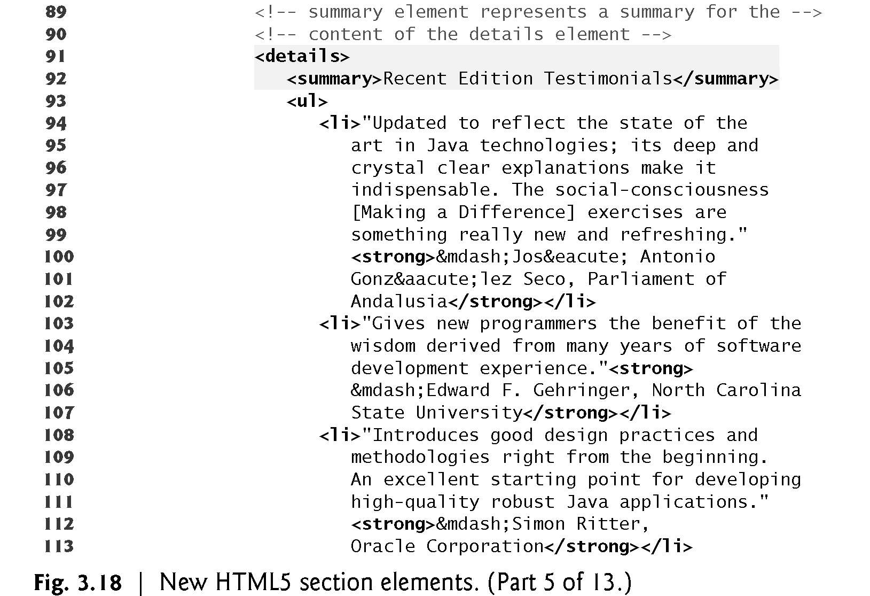

Slide 74
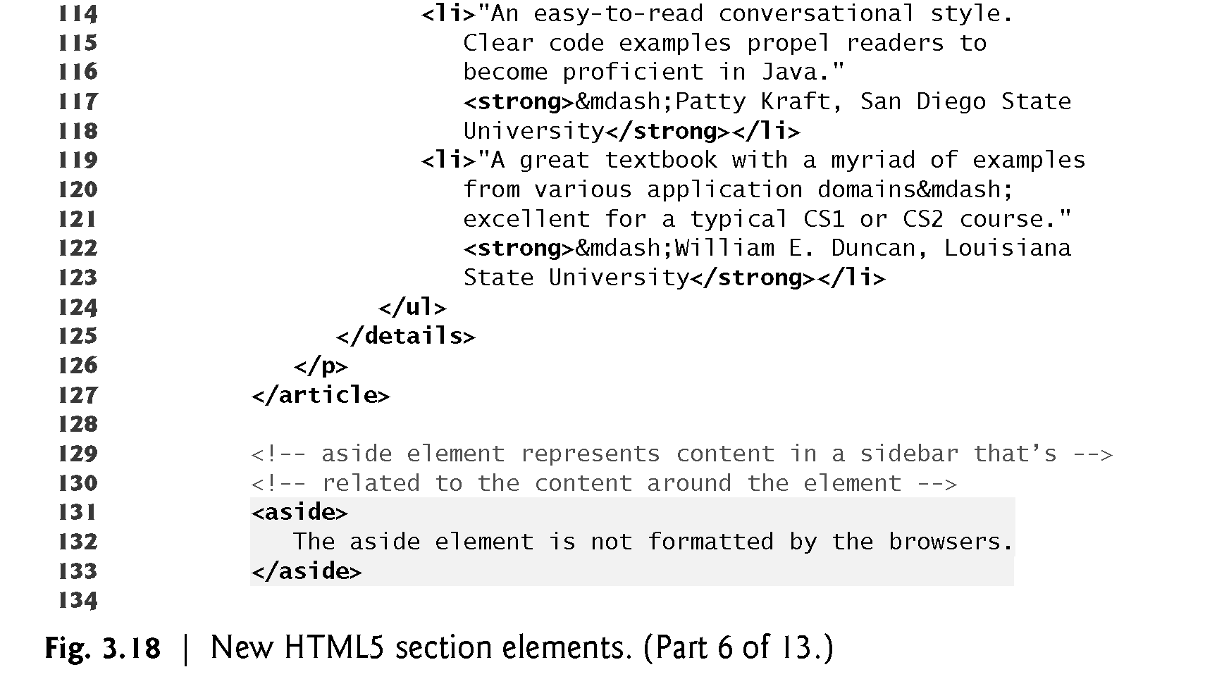

Slide 75
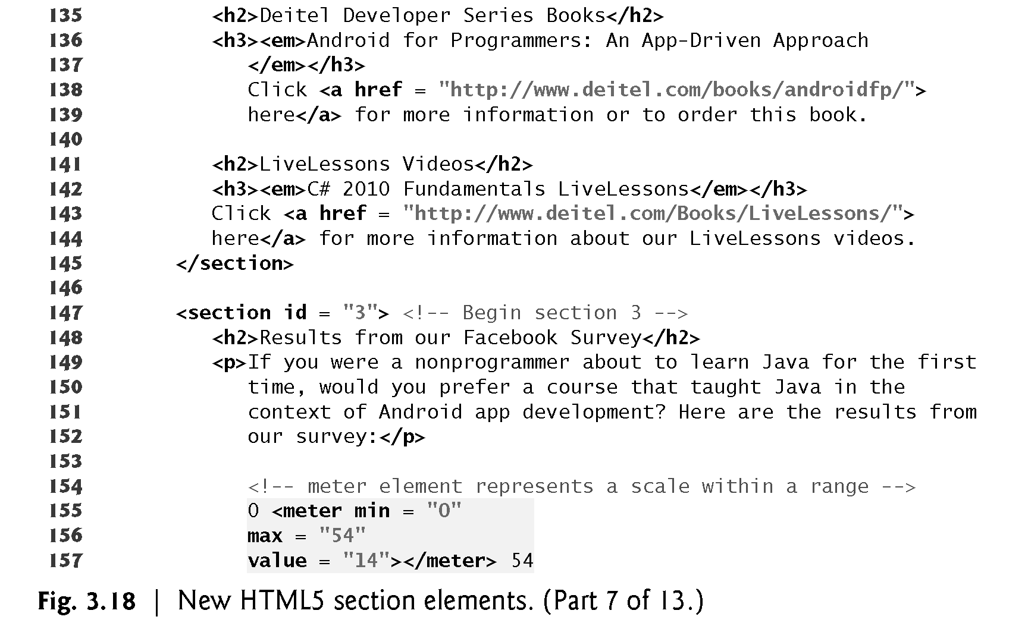

Slide 76
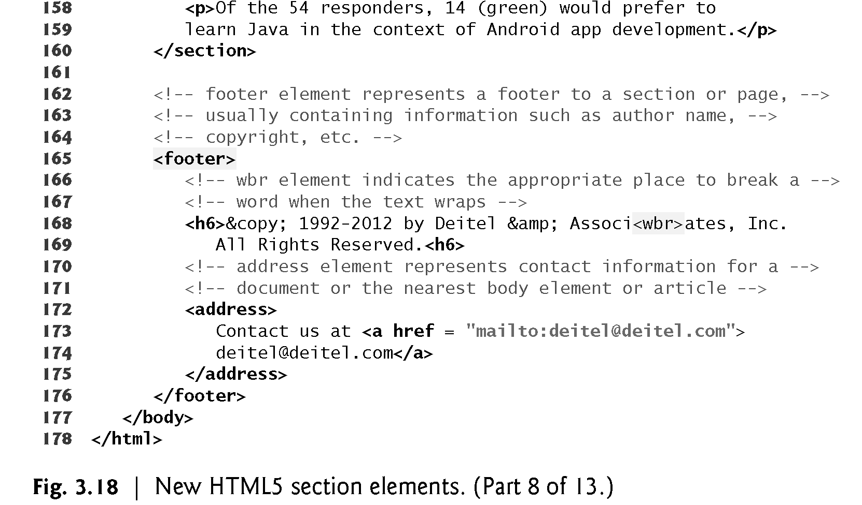

Slide 77
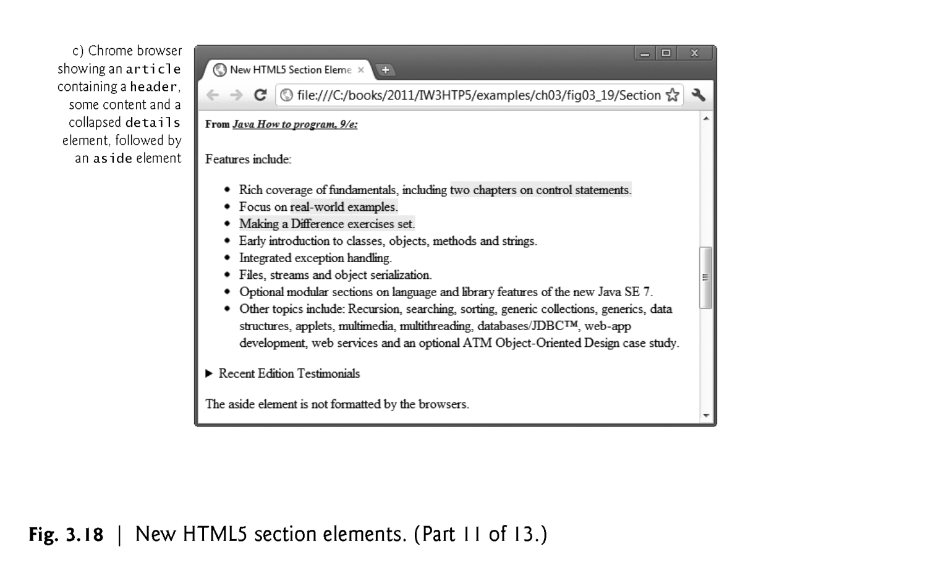

Slide 78
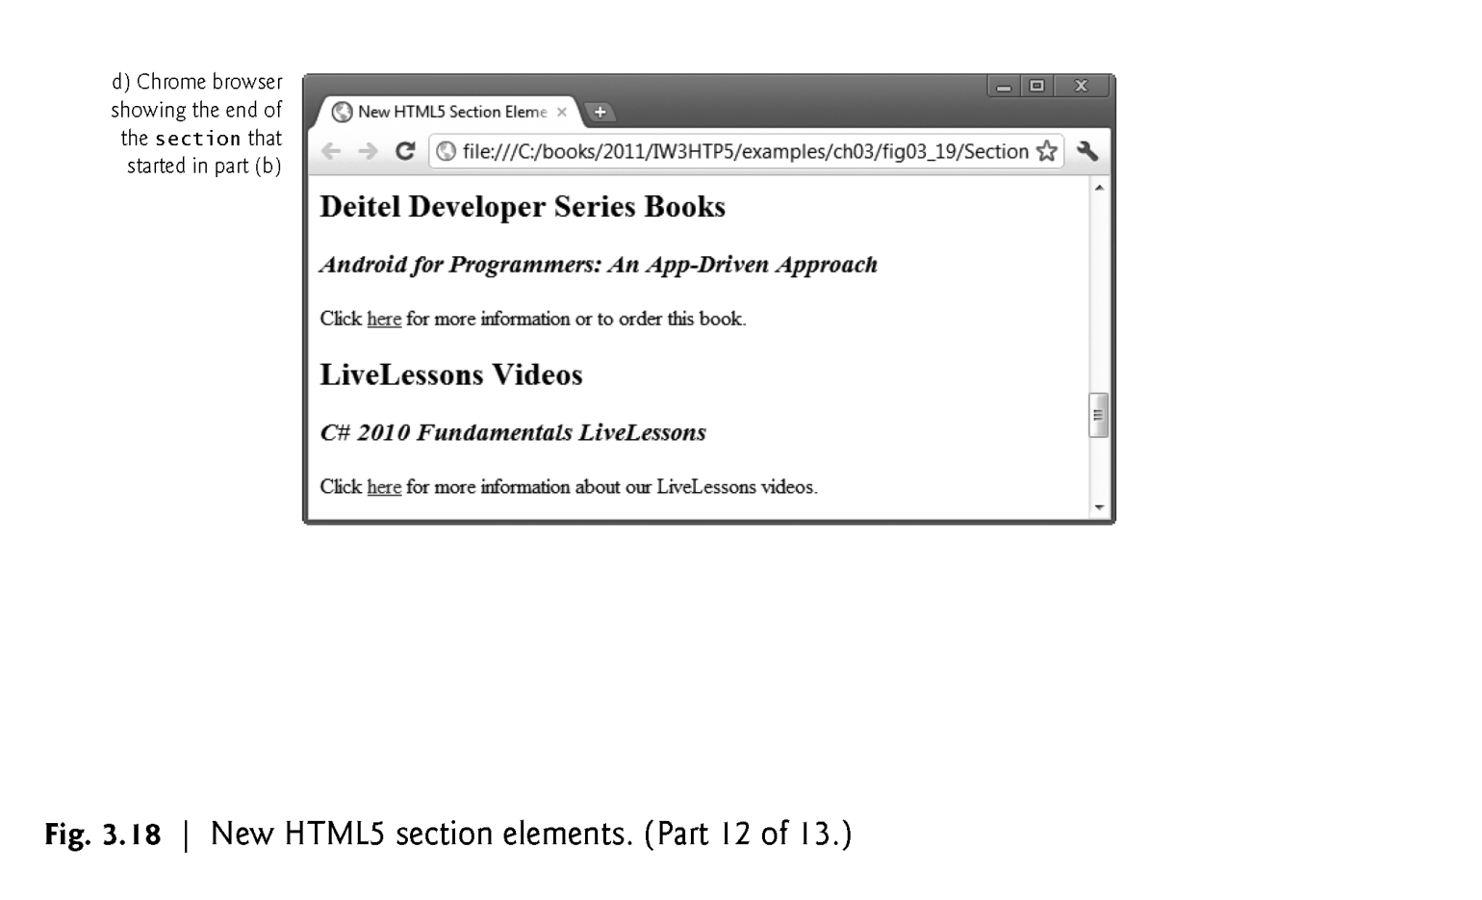

Slide 79
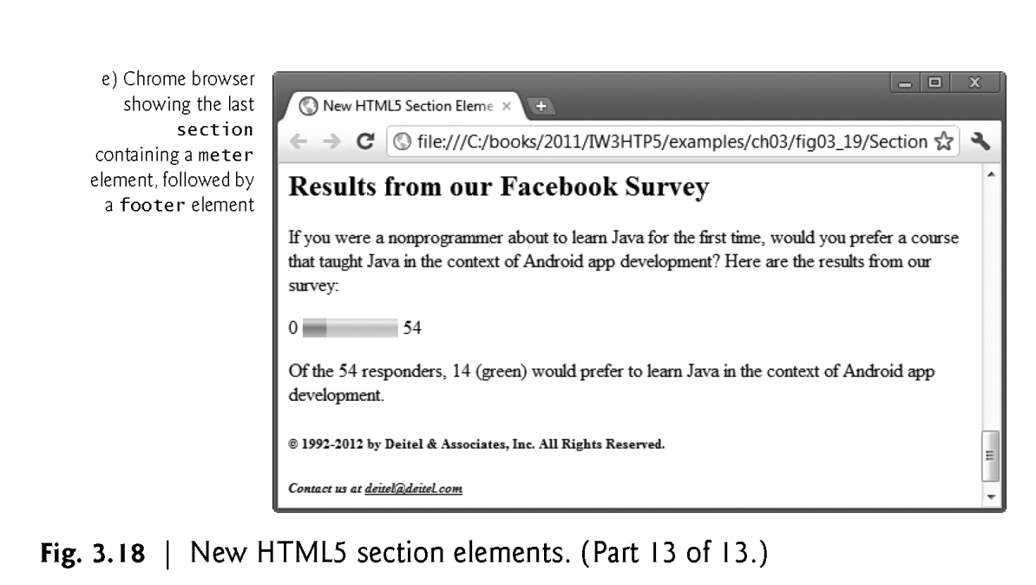

Slide 80
nav Element
The nav element groups navigation links.
In this example, we used the heading Recent Publications and created a ul element with seven li elements that link to the corresponding web pages for each book.

Slide 81
article Element
The article element describes standalone content that could potentially be used or distributed elsewhere, such as a news article, forum post or blog entry.
You can nest article elements. For example, you might have reader comments about a magazine nested as an article within the magazine article.

Slide 82
summary Element and details Element
The summary element displays a right-pointing arrow next to a summary or caption when the document is rendered in a browser (Fig. 3.19).
When clicked, the arrow points downward and reveals the content in the details element.

Slide 83
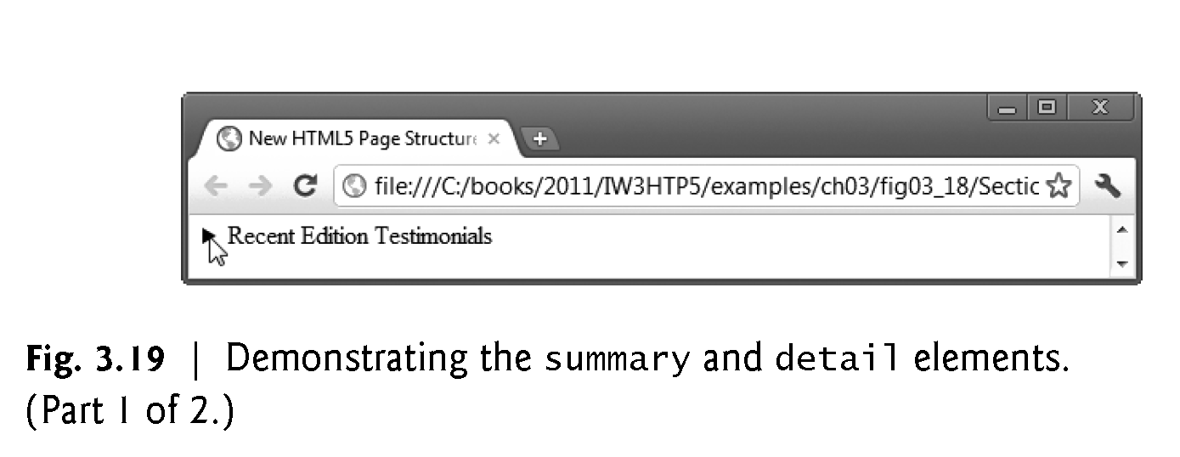

Slide 84
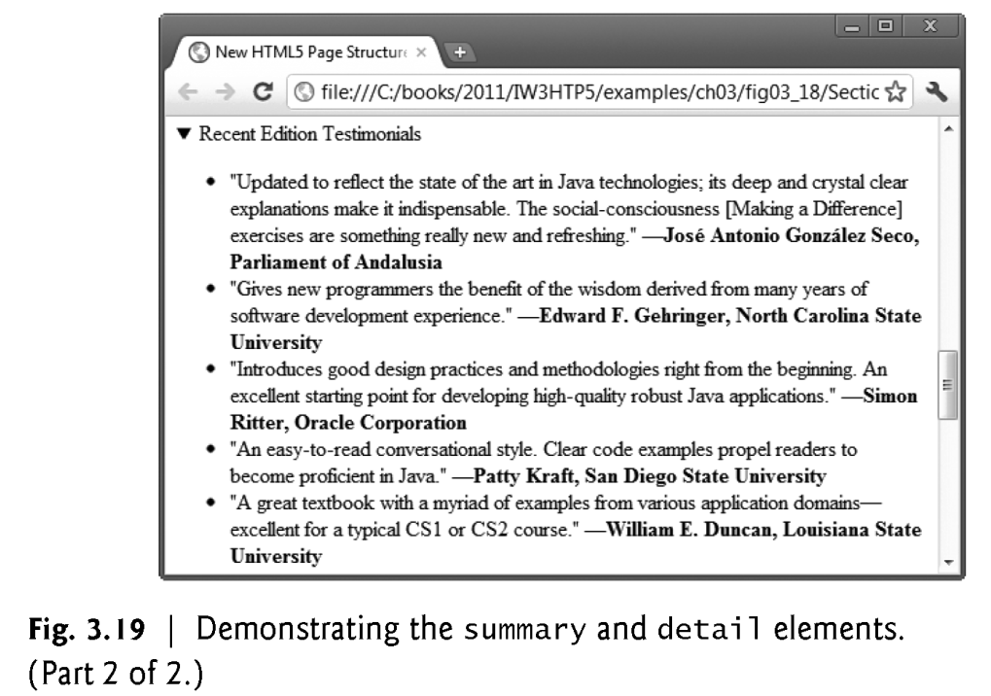

Slide 85
aside Element
The aside element describes content that’s related to the surrounding content (such as an article) but is somewhat separate from the flow of the text.
For example, an aside in a news story might include some background history.

Slide 86
meter Element
The meter element renders a visual representation of a measure within a range (Fig. 3.20).
In this example, we show the results of a recent web survey we did.
The min attribute is "0" and a max attribute is "54" —indicating the total number of responses to our survey.
The value attribute is "14", representing the total number of people who responded “yes” to our survey question.

Slide 87
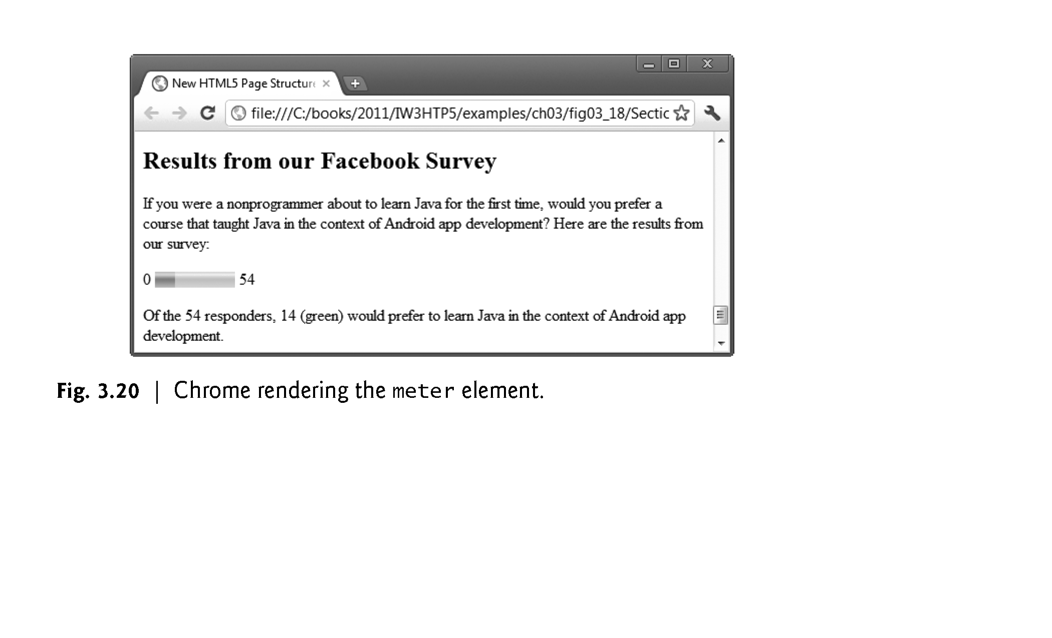

Slide 88
Forms
What are forms?
An HTML form is an area of the document that allows users to enter information into fields.
A form may be used to collect personal information, opinions in polls, user preferences and other kinds of information.

Slide 89
Forms
There are two basic components of a Web form: the shell, the part that the user fills out, and the script which processes the information
HTML tags are used to create the form shell. Using HTML you can create text boxes, radio buttons, checkboxes, drop-down menus, and more...

Slide 90
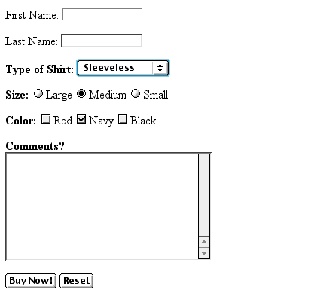
Example: Form
Text Box
Drop-down List
Radio Buttons
Checkboxes
Text Area
Reset Button
Submit Button

Slide 91
Applications of Forms
Contact form
Registration form
Sign-in Form
Lead generation form
Order form
Survey form
Search form
Email form

Slide 92
The Form Shell
A form shell has three important parts:
the <FORM> tag, which includes the address of the script which will process the form
the form elements, like text boxes and radio buttons
the submit button which triggers the script to send the entered information to the server

Slide 93
Syntax
<body>
<form method="post" action="script_url">
. . . . . form fields……
</form>
</body>
Here, the form action specifies the location where the form data will be submitted, and the form method specifies the HTTP method that is usually GET / POST.
If you do not specify the action and method attribute in the form element, the default action will be the current page, and the method will be GET.

Slide 94
text | It defines a single-line text field. | <input type="text">
email | It defines a single-line text field for an e-mail address. The input value is automatically verified to ensure correctly formatted email addresses. | <input type="email">
password | It defines a single-line text field for password. | <input type="password">
radio | It defines a radio button. Radio buttons are usually presented in a radio group and allow the user to select only one option. | <input type="radio">

Slide 95
checkbox | It defines a checkbox button. Checkbox buttons are usually presented in a group and allow the user to select multiple options. | <input type="checkbox">
file | File input provides a browse button to select files to upload. On clicking the button, it opens a file picker dialog from which the user can select files. | <input type="file">

Slide 96
image | Image input provides a browse button to select images for upload. On clicking the button, it opens a file picker dialog from which the user can select only images. | <input type="image">
hidden | Hidden inputs are invisible from users. They allow developers to get some textual data that the user cannot see. | <input type="hidden">

Slide 97
submit | The submit input creates a submit button. On clicking the button, It submits all the form elements to the form handler. | <input type="submit">
reset | The reset input creates a reset button. On clicking the button, It reset all the form elements value to the default state. | <input type="file">
button | The button input creates a simple button that can be programmed to perform some action. | <input type="button">

Slide 98
HTML 5 Input Types
number | It defines a single-line text field for only numbers. | <input type="number">
tel | It defines a single-line text field for telephone numbers. | <input type="tel">
range | It displays a slider to set the value of an input element. | <input type="range">
url | It defines a single-line text field for a URL address. The input value is automatically verified to ensure a correctly formatted URL. | <input type="url">

Slide 99
HTML 5 Input Types
search | It defines a single-line text field that is styled differently by web browsers. | <input type="search">
color | It provides an interface to select colors using a visual color picker. | <input type="color">
date | It displays a calendar to select a date that is styled differently by different web browsers. | <input type="date">

Slide 100
<form name="Search" method="post" action="search.php" >
<label for="q">Search:</label><br />
<input type="search" name="q" id="q" /> <br/>
<input type="submit" value="Go" />
</form>

Slide 101
time | It is used to specify single-line text fields for the time input (hours, minutes, and seconds optionally) format. | <input type="time">
datetime-local | It displays a calendar to select both date and time. | <input type="datetime-local">
month | It displays a calendar to select a month. | <input type="month">
week | It displays a calendar to select a week. | <input type="week">

Slide 102
Creating Text Boxes
To create a text box, type <INPUT TYPE=“text” NAME=“name” VALUE=“value” SIZE=n MAXLENGTH=n>
The NAME, VALUE, SIZE, and MAXLENGTH attributes are optional

Slide 103
Text Box Attributes
The NAME attribute is used to identify the text box to the processing script
The VALUE attribute is used to specify the text that will initially appear in the text box
The SIZE attribute is used to define the size of the box in characters
The MAXLENGTH attribute is used to define the maximum number of characters that can be typed in the box

Slide 104

Example: Text Box
First Name: <INPUT TYPE="text" NAME="FirstName" VALUE="First Name" SIZE=20>
<BR><BR>
Last Name: <INPUT TYPE="text" NAME="LastName" VALUE="Last Name" SIZE=20>
<BR><BR>
Here’s how it would look on the Web:

Slide 105
Creating Larger Text Areas
To create larger text areas, type <TEXTAREA NAME=“name” ROWS=n1 COLS=n2 WRAP> Default Text </TEXTAREA>, where n1 is the height of the text box in rows and n2 is the width of the text box in characters
The WRAP attribute causes the cursor to move automatically to the next line as the user types

Slide 106
Example: Text Area
<B>Comments?</B>
<BR>
<TEXTAREA NAME="Comments" ROWS=10 COLS=50 WRAP>
</TEXTAREA>

Slide 107
Creating Radio Buttons
To create a radio button, type <INPUT TYPE=“radio” NAME=“name” VALUE=“data”>Label, where “data” is the text that will be sent to the server if the button is checked and “Label” is the text that identifies the button to the user

Slide 108
Example: Radio Buttons
<B> Size: </B>
<INPUT TYPE="radio" NAME="Size" VALUE="Large">Large
<INPUT TYPE="radio" NAME="Size" VALUE="Medium">Medium
<INPUT TYPE="radio" NAME="Size" VALUE="Small">Small

Slide 109
Creating Checkboxes
To create a checkbox, type
<INPUT TYPE=“checkbox” NAME=“name” VALUE=“value”>Label
If you give a group of radio buttons or checkboxes the same name, the user will only be able to select one button or box at a time

Slide 110
Example: Checkboxes
<B> Color: </B>
<INPUT TYPE="checkbox" NAME="Color“ VALUE="Red">Red
<INPUT TYPE="checkbox" NAME="Color" VALUE="Navy">Navy
<INPUT TYPE="checkbox" NAME="Color“ VALUE="Black">Black

Slide 111
Creating Drop-down Menus
To create a drop-down menu, type
<SELECT NAME=“name” SIZE=n MULTIPLE>
Then type
<OPTION VALUE= “value”>Label </OPTION>
In this case the SIZE attribute specifies the height of the menu in lines and MULTIPLE allows users to select more than one menu option

Slide 112
Example: Drop-down Menu
<B>WHICH IS FAVOURITE FRUIT:</B>
<SELECT>
<OPTION VALUE="MANGOES">MANGOES </OPTION>
<OPTION VALUE="PAPAYA">PAPAYA </OPTION>
<OPTION VALUE="GUAVA">GUAVA </OPTION>
<OPTION VALUE="BANANA"> BANANA </OPTION>
<OPTION VALUE="PINEAPPLE">PINEAPPLE </OPTION>
</SELECT>

Slide 113
Creating a Submit Button
To create a submit button, type
<INPUT TYPE=“submit”>
If you would like the button to say something other than submit, use the VALUE attribute
For example,
<INPUT TYPE=“submit” VALUE=“Buy Now!”>
would create a button that says “Buy Now!”

Slide 114
Creating a Reset Button
To create a reset button, type <INPUT TYPE=“reset”>
The VALUE attribute can be used in the same way to change the text that appears on the button

Slide 115
Fieldset - Legend
Fieldset
Group thematically related controls and labels in a form.
[Grouping controls makes it easier for users to understand their purpose while simultaneously facilitating tabbing navigation]
Draws a box around the related elements.
Legend
Used to define a caption for the <fieldset> element.
Improves accessibility

Slide 116
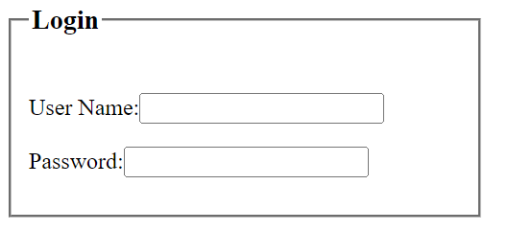
Fieldset & Legend
<fieldset style="width: 300px">
<legend><h3>Login</h3></legend>
<p>User Name:<input type="text"></p>
<p>Password:<input type="password"></p>
</fieldset>

